Slide 1

Dating with Data Science
Predicting Attractiveness
Dating in today’s world can be challenging due to vast amount of options to meet people and the busy work and social schedules of singles. To be successful, people must be attracted to their dates and most people need to have a face to face date with someone before determining if they are attracted to them. In addition, attraction can be based on more than physical appearance or online photo.
Can we predict someone’s attractiveness without photos? Is their attractiveness linked to their self-perception, social habits, and attitude about dating? Does it differ for males and females?
Data Source: https://www.kaggle.com/annavictoria/speed-dating-experiment

Slide 2
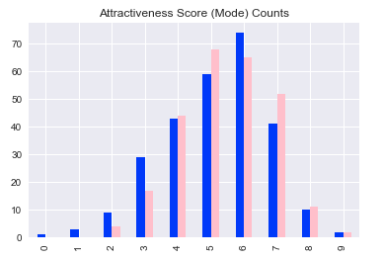
The DataSet
Speed Dating Experiment
Columbia University conducted a speed dating experiment consisting of 8378 dates over 21 Dating Events. Each Subject goes on 4-minute “dates” with 5 – 21 Partners in a local bar setting.
534 Unique Participants. 271 Males. 263 Females.
Prior to event, Subjects rate themselves from 1-10 in 5 categories:
Attractive, Sincere, Fun, Intelligent, and Ambitious
Each Subject also indicates their social habits and outlook:
Dating Frequency, Going out Frequency, Expected Happiness from Event, and Dating Goals
At end of each date, in addition to deciding date/not date again, Partner rates them 1-10 on attractiveness.

Slide 3
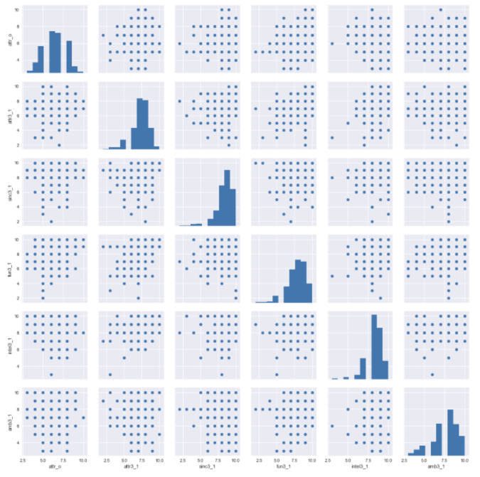
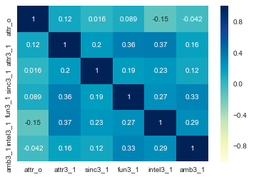
EDA – Self-Perception vs Attractiveness (F)
Conclusions
Not much of correlation of attr_o with self perception for Females
No correlation with social or outlook features (not shown)

Slide 4
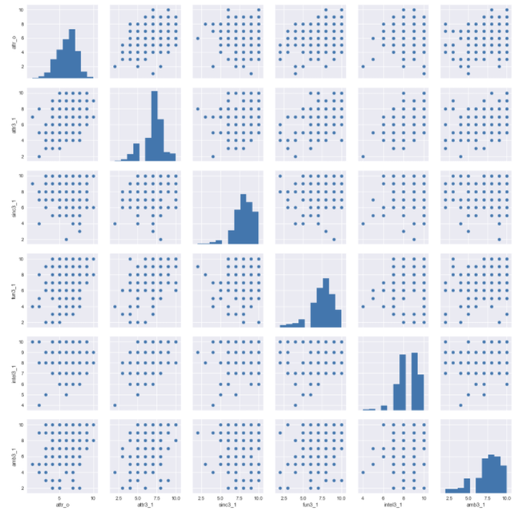
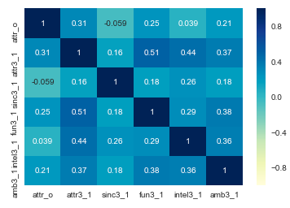
EDA – Self-Perception vs Attractiveness (M)
Conclusions
Slight correlation of attr_o with attr3_1 and fun3_1 and amb3_1 for Males
No correlation with social or outlook features (not shown)

Slide 5
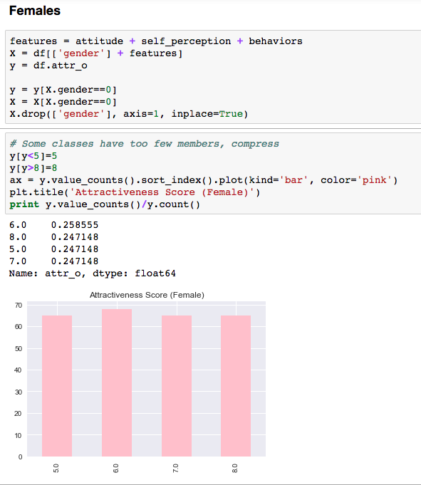
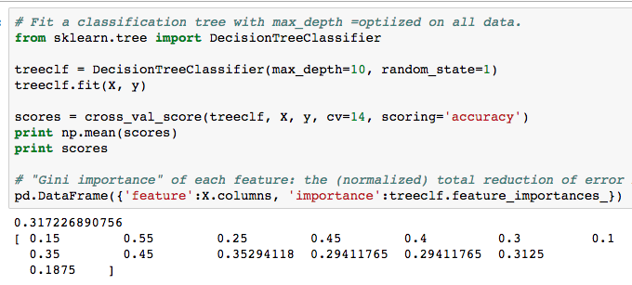
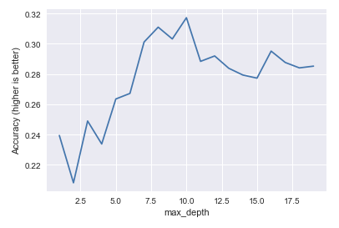
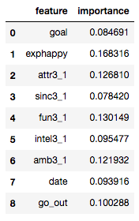

Modeling – decision Trees (Classifier)
Decision Tree could provide insight into importance of features and attractiveness (Gini Scores) and could reveal subconscious decision making process (Tree)

Slide 6
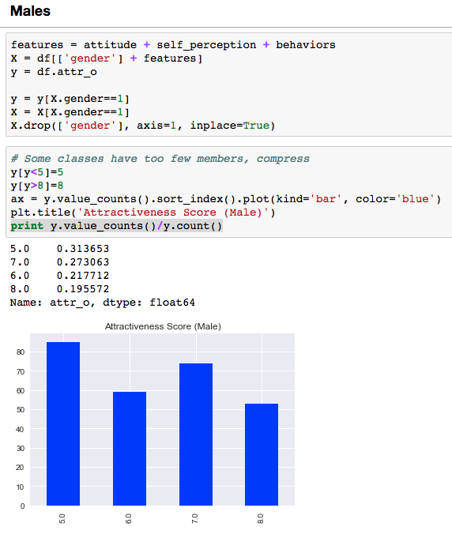
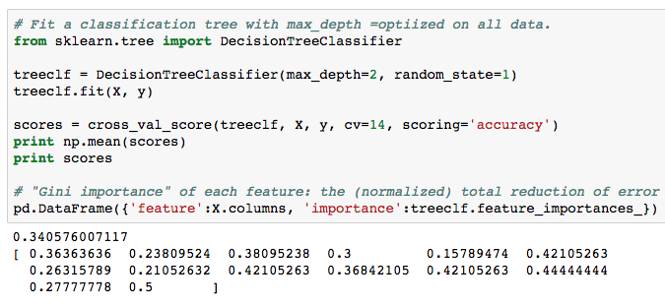
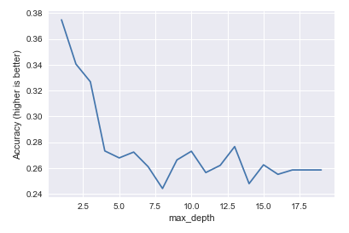
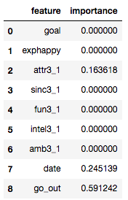
Modeling – decision Trees (Classifier)

Slide 7
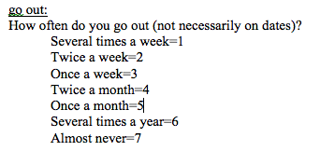
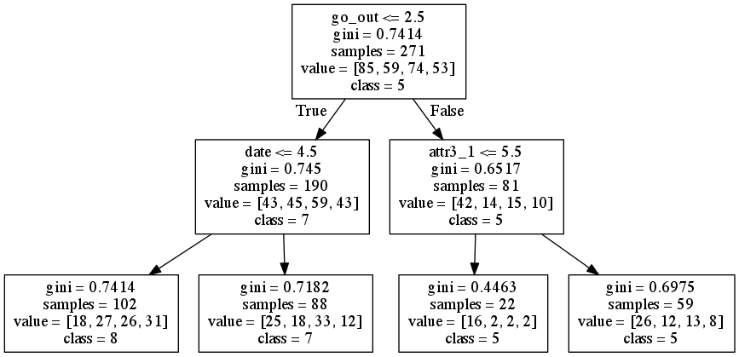
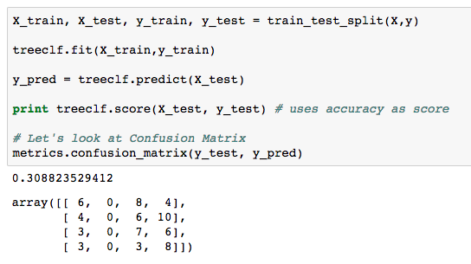
Modeling – decision Trees (Classifier)
Guys: Go out and date more often!

Slide 8
Conclusions
Decision Trees not very accurate in predicting attractiveness based on questionnaire.
Tried Binary Classification (>7). No better prediction accuracy.
Tried Logistic Regression and Random Forest Classifiers. No better prediction accuracy .
Confounders probably play a greater role in predicting attractiveness. May depend on partner’s attributes and preferences.
Maybe photos do matter. Download Tinder. Go out more. Date more.

